Slide 1


Titolo presentazione sottotitolo
Online Learning Application
Milano, XX mese 20XX
Project 2023-2024

Slide 2

Firma convenzione Politecnico di Milano e Veneranda Fabbrica del Duomo di Milano
Team Members
Benedini Alice 10699518
Meanti Luca 10623762
Tenedini Davide 10651360
Wu Yizhou 10926468
Aula Magna – Rettorato
Mercoledì 27 maggio 2015

Slide 3
Requirement 1
Stochastic Environment

Slide 4
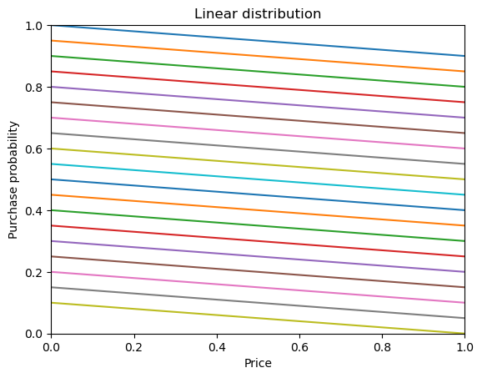
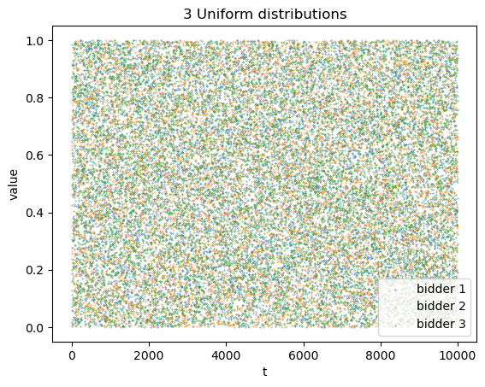
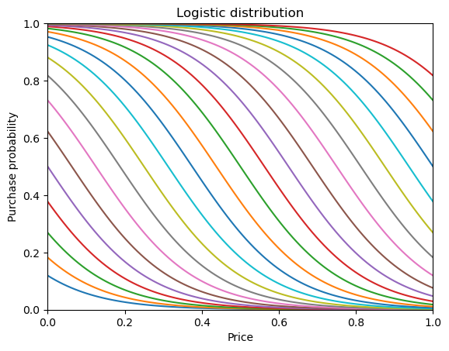
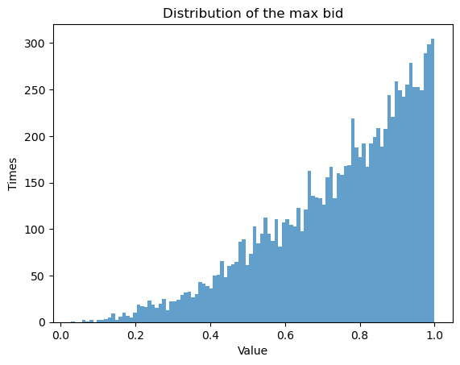
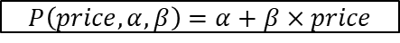
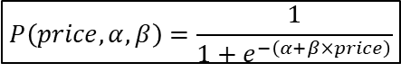
Pricing and Bidding Environments
Purchase probability
Opponent bids (3 opponents)
$P\left(price,α,β\right)=$ $α+β×price$
$$P\left(price,α,β\right)=\frac{1}{1+e^{−\left(α+β×price\right)}}$$

Slide 5
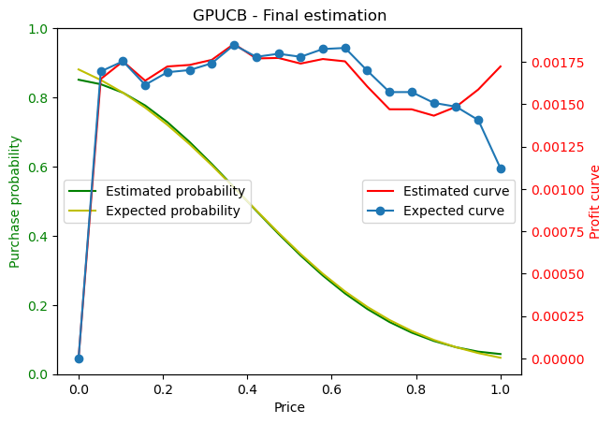
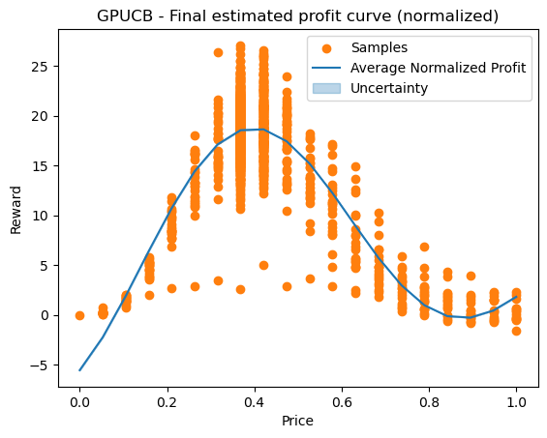
Pricing Agent Gaussian Process UCB agent
Agent decision process for pricing:
1. Sample purchase probabilities for all prices and customers with GP
2. Probabilities * prices => estimated profit
3. Estimated profits – average bidding cost => estimated net profit
4. Estimate net profit * average customer number => net profit (total)
Bidding
Agent
Bidding Environment
Pricing
Agent
Pricing Environment
Fig.1 : GP fitted on purchase probability
Fig.2 : GP fitted on total profit

Slide 6
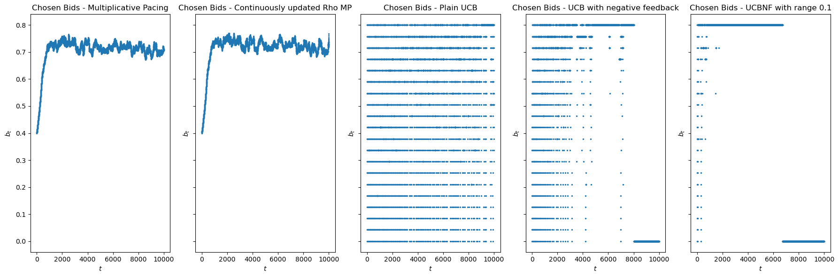
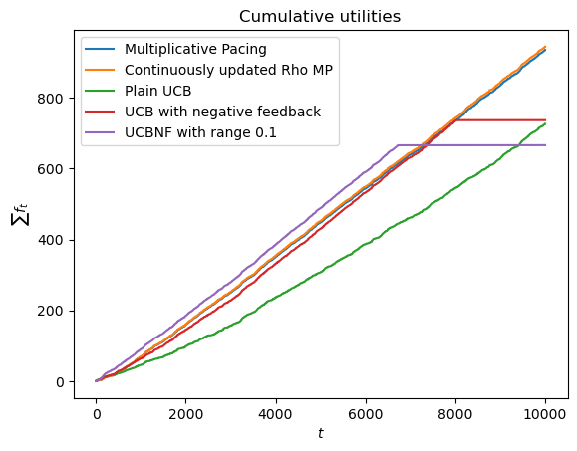
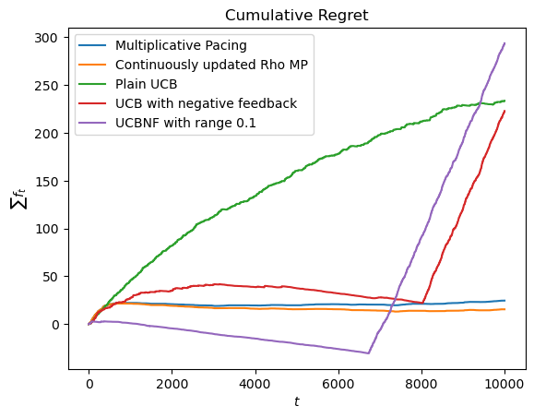
Bidding Agents 1. Primal-Dual algorithm for truthful auctions 2. UCB-like algorithm
def update(self, f_t, c_t):
self.N_pulls[self.a_t] += 1
if(f_t>0):
self.won_time += 1
self.winning_total_reward += f_t
elif(self.t >= self.K):
f_t = -(self.total_reward/self.won_time)
self.average_rewards[self.a_t] +=
(f_t-self.average_rewards[self.a_t])/self.N_pulls[self.a_t]
self.budget -= c_t
self.t += 1
def update(self, f_t, c_t):
# update lmbd and budget
# …
# update rho (per round budget)
self.t += 1
self.rho = self.budget/(self.T-self.t)
Parameters:
3 uniform distributed opponents
v=0.8
B=2000
T=10000
# of Wins: [ 3560,
3678,
2838,
3421,
3332 ]

Slide 7
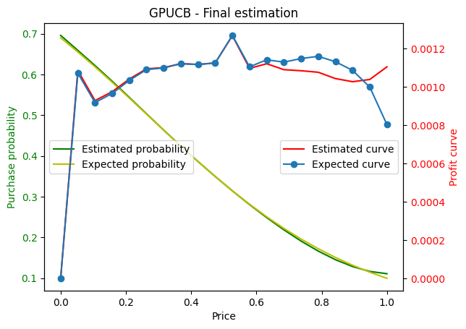
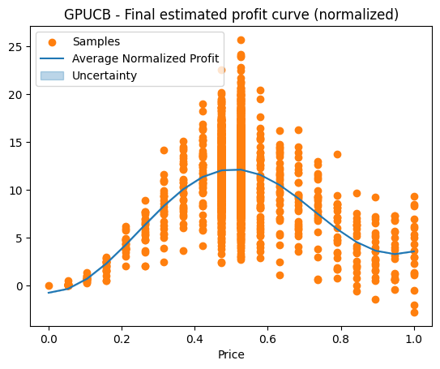
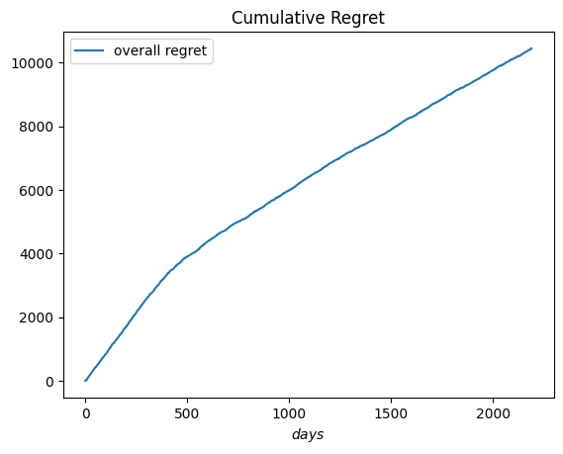
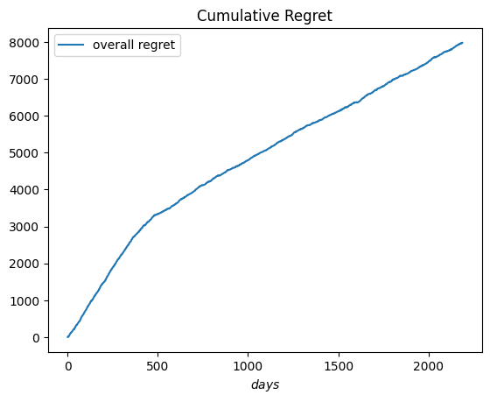
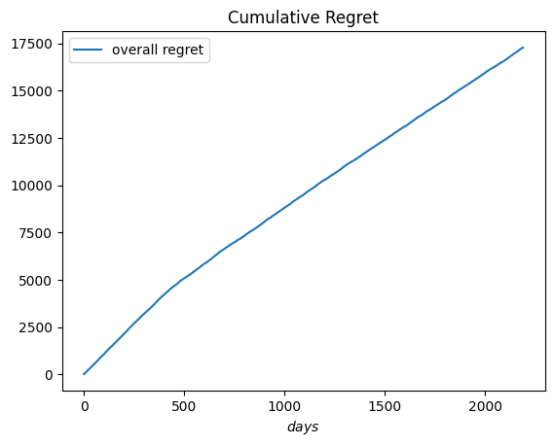
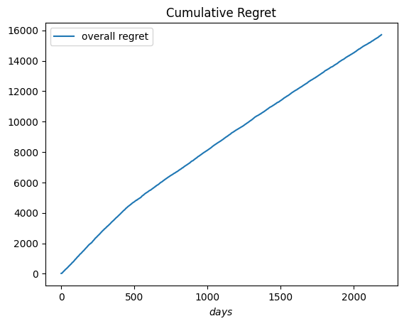
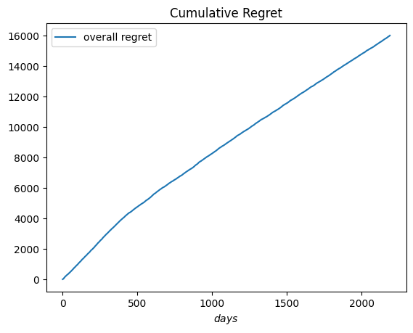
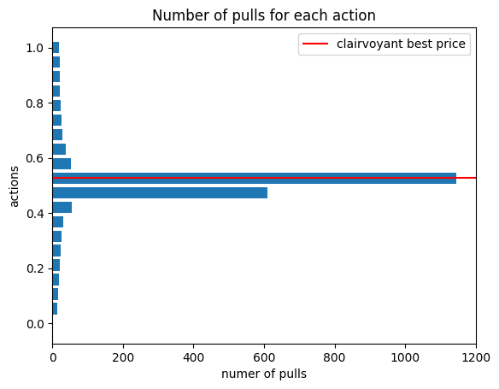
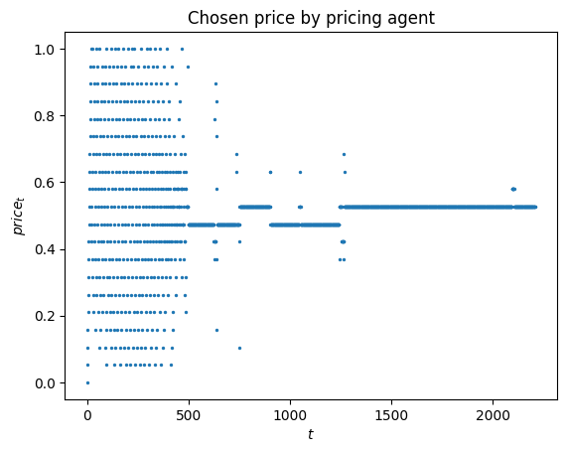
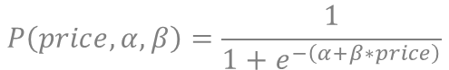
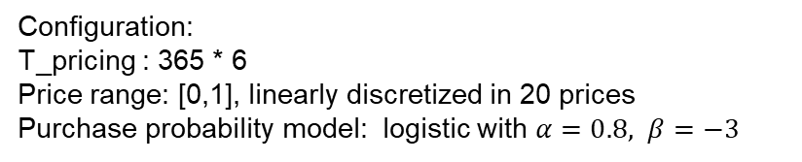
Interaction
Configuration:
T_pricing : 365 * 6
Price range: [0,1], linearly discretized in 20 prices
Purchase probability model: logistic with $α=0.8, β=−3$
0.0012 * 10000 ~= 12
T_bidding : 10000
Budget : 100
Opponents : 2 uniform bidders (infinite budget)
$$P\left(price,α,β\right)=\frac{1}{1+e^{−\left(α+β∗price\right)}}$$
Multiplicative Pacing
Continuously updated rho MP
UCB1
UCB1 with Negative Feedback
UCB1 with NF and lower scale

Slide 8
Requirement 2 Adversarial Setting

Slide 9
Requirement 2 Pricing

Slide 10
Environment
Purchase probability: $p\left(x\right)=\frac{1}{e^{−(α+ β∗x)}}$
$β$ parameter perturbations:
Jump days:
Number: $Poi(θ)$
Magnitude: $N(0, S)$
Normal days:
Magnitude: $N(0, s)$
Length between jumps:
$N(μ, σ^{2})$
Hyperparameters
- 1 Year, 4 Seasons:
- $θ$= 4
- $μ$= 90, $σ^{2}$= 30
- Probability consistent:
$α$= 1
$S$= 2
$s$= 0.01

Slide 11
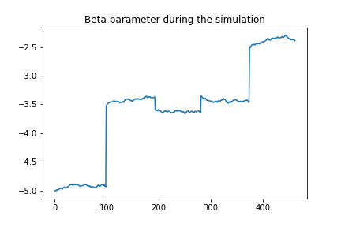
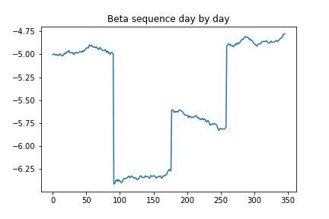
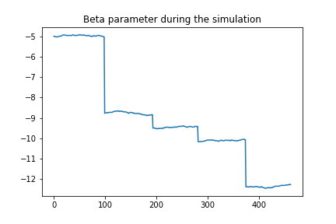
Environment
Here are some interesting situations that arose from the simulations. Moving clockwise, we can observe the cases of a successful, unsuccessful, and fluctuating product.

Slide 12
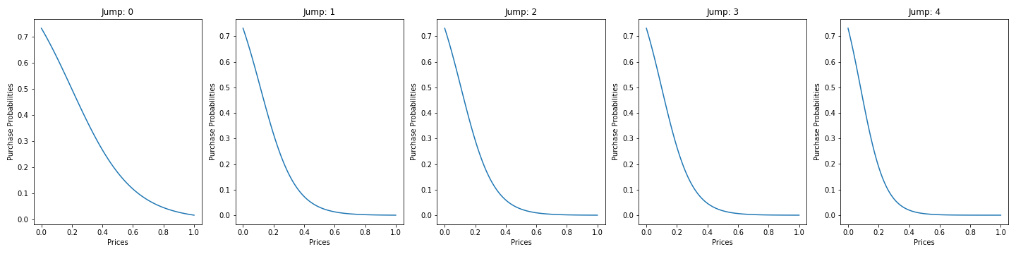
Environment Unsuccessful Product
In the graphs below one can appreciate the purchase probability in correspondence of the jump days.

Slide 13
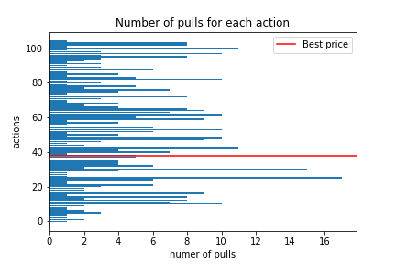
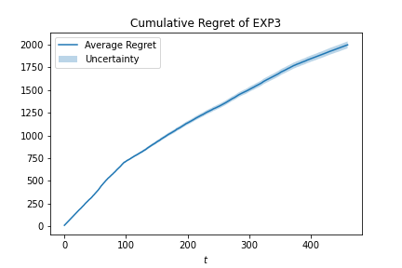
Agent: EXP3
EXP3 does not converge to a single arm, as it continuously explores to avoid being impacted by environmental changes. However, it tends to select arms that are close to the optimal one more frequently, resulting in a sublinear cumulative regret.

Slide 14
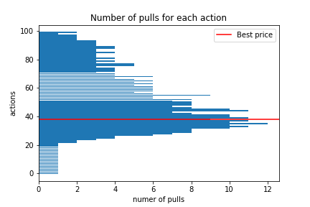
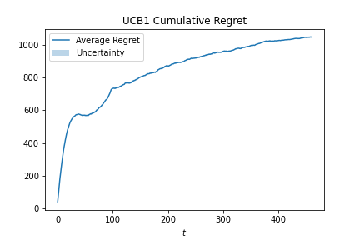
Agent: UCB1
UCB1 converges to the optimal arm, with its cumulative regret characterized by a first superlinear part, corresponding to the exploration phase followed by a sublinear one, relative to the exploitation phase, where it increasingly exploits the best arms.
Notice that the regret magnitude is half of the EXP3 one and the sublinear trend is more evident.

Slide 15
Requirement 2 Advertising

Slide 16
Environment
Generalized first price auction, with 4 competitors and 3 identical slots available.
Competitors starting bid:
- $N(μ, σ^{2})$
Users simulation:
Jumps number : $Poi(θ)$
Length between jumps: $N(α,β)$
$μ$ perturbations magnitude:
Jump users: $N(0, S)$
Other users: $N(0, s)$
Hyperparameters
- Competitors bids:
- $μ$ = 0.5
- $σ^{2}$ = 0.05
- 1 Day, 3 different phases:
- $θ$= 3
- $α$= ${10}^{4}$, $β$= ${10}^{2}$
- Perturbations:
- S = 0.1
- s = 0.001

Slide 17
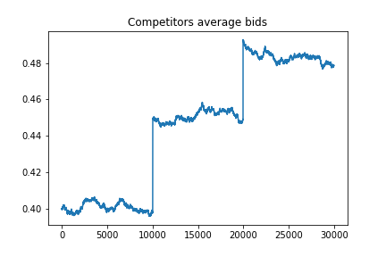
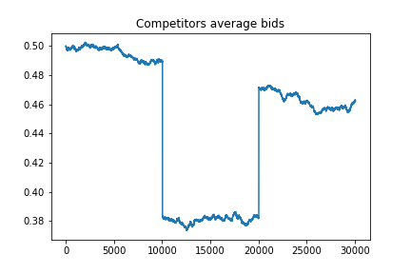
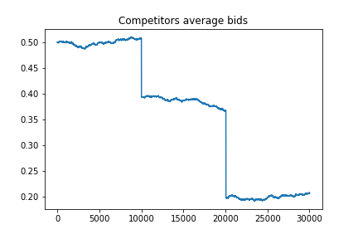
Environment
Here are some interesting situations that arose from the simulations. Moving clockwise, we can observe the case of a day in which the expected competitors bid is increasing, decreasing, and not monotonic.

Slide 18
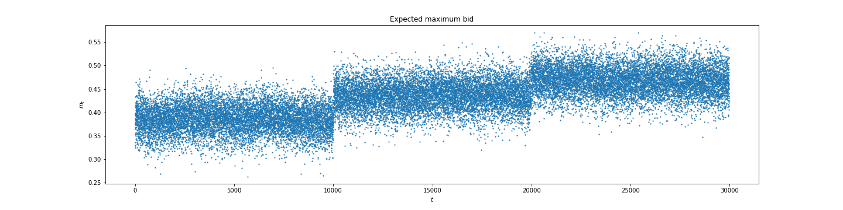
Environment Competitors increasing bids
Focus on an day where the competitors average bid increases.
In the graph below one can appreciate the expected maximum bid and its changes during the simulation.

Slide 19
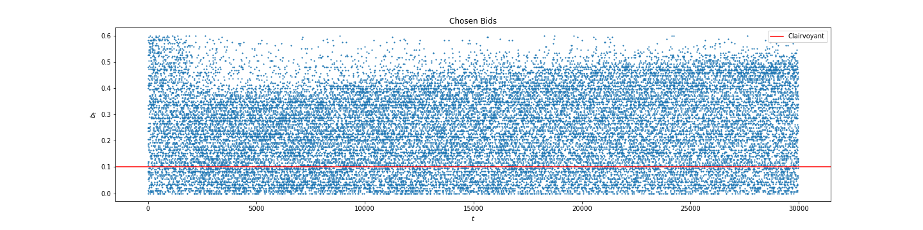
Agent: Full Feedback Multiplicative Pacing with Hedge Low Budget
Using a budget of approximately 1/5 of that of the competitors, the agent exhibits a more conservative behavior, heavily biased towards exploration. Although this exploration moves in the right direction, the exploitation process is significantly lacking. This is likely due to the low budget per round, which prevents the agent from adequately exploring higher bids.

Slide 20
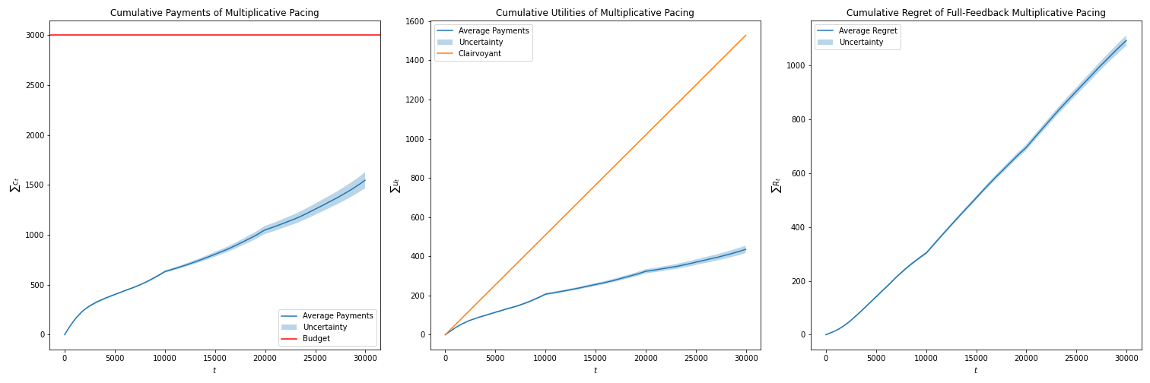
Agent: Full Feedback Multiplicative Pacing with Hedge Low Budget
It is important to note that, despite the low budget, the agent tends not to deplete it, distributing it throughout the entire simulation. Comparing the cumulative utility with that of the clairvoyant reveals the poor performance of our agent, as it only achieves sublinear cumulative utilities. Compared to the linear utility of the clairvoyant, this results in a cumulative regret that is linear or even superlinear.

Slide 21
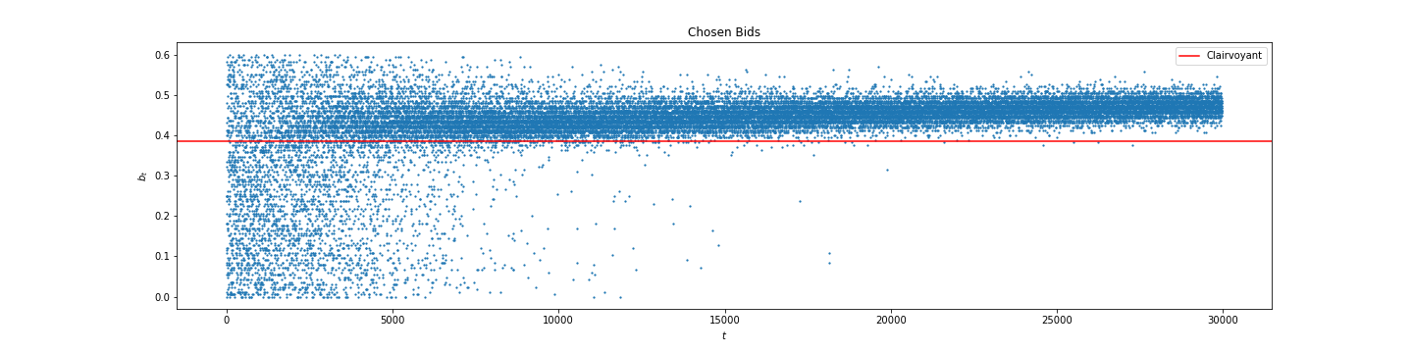
Agent: Full Feedback Multiplicative Pacing with Hedge Fair Budget
Assigning a budget similar to that of the competitors, our agent seems to achieve a good balance between exploration and exploitation phases. Notably, there is a predominant exploration phase at the beginning, after which the agent settles into a range of competitive bids with a slightly increasing trend, as much as possible. It is important to remember, indeed, that our agent’s valuation is 0.6, and at some point, the winning bids approach this value closely.

Slide 22
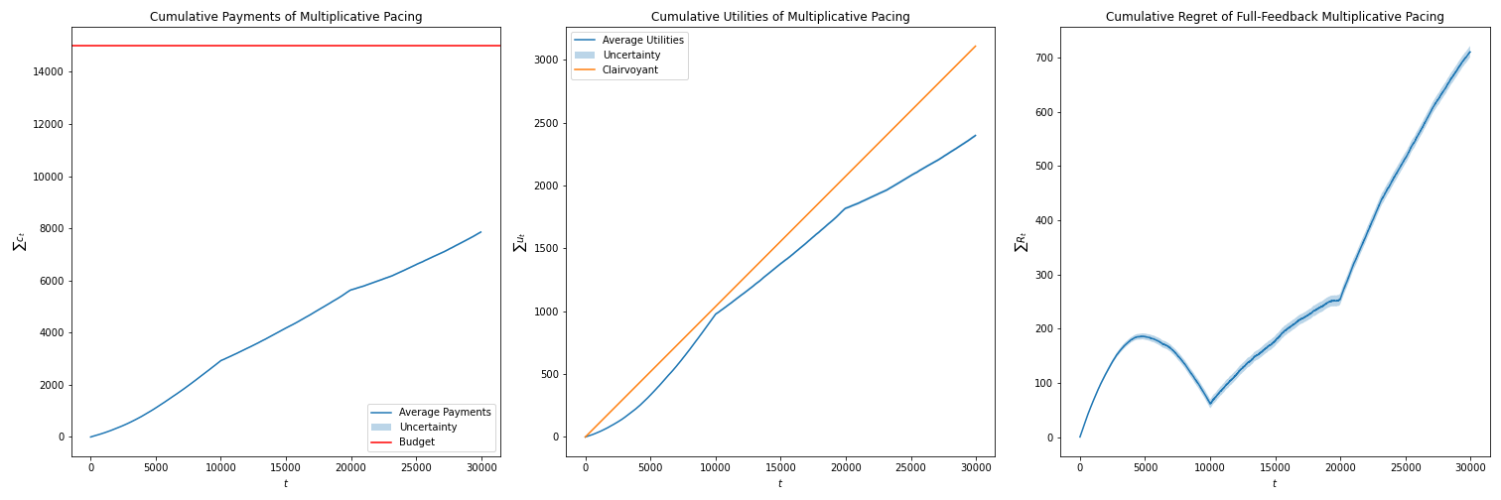
Agent: Full Feedback Multiplicative Pacing with Hedge Fair Budget
As in the previous case, the budget is not depleted. The cumulative utility is sublinear during the initial exploration phase (t < 5000), then becomes superlinear once the winning bid range is identified (5000 < t < 10000). Due to increasing jumps, the winning bid closely approaches the agent’s valuation, resulting in a linear trend (10000 < t < 20000) and eventually a sublinear trend (t > 20000). This behavior is also evident in the cumulative regret plot.

Slide 23
Requirement 2 Interaction

Slide 24
Pricing and Advertising Strategies
We selected the most promising scenario from the pricing simulations, where the logistic function describing the purchase probability experiences decreasing perturbations.
Each day, the price is reassessed based on the number of customers brought in by the previous day's advertising campaign, combined with the purchase probability used
Pricing Agent: UCB1 is used to select the optimal price.
Advertising Agent: FFMultiplicative Pacing with Hedge is employed to optimize the advertising strategy

Slide 25
Daily Interaction Process
Each day, the UCB1 pricing agent selects a price.
The selected price is passed to the advertising agent, which subtracts the product cost to define its valuation.
The advertising agent uses this valuation to run the day's advertising campaign.
The outcome of the campaign, based on the number of auctions won, determines the new number of customers.
This customers number, along with the purchase probability determines the new rewards for each price.
The pricing agent uses these rewards to selects the new price.

Slide 26
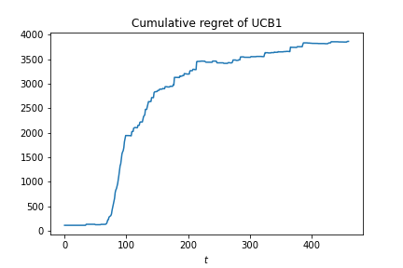
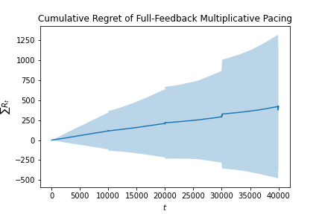
Results
Both algorithms achieve sublinear regret relative to their respective baselines, which are based on static policies. In the pricing part, the baseline is the optimal arm in terms of cumulative reward. For the advertising agent, the baseline is the best bid determined by a linear programming solution with budget constraints.

Slide 27
Requirement 3

Slide 28
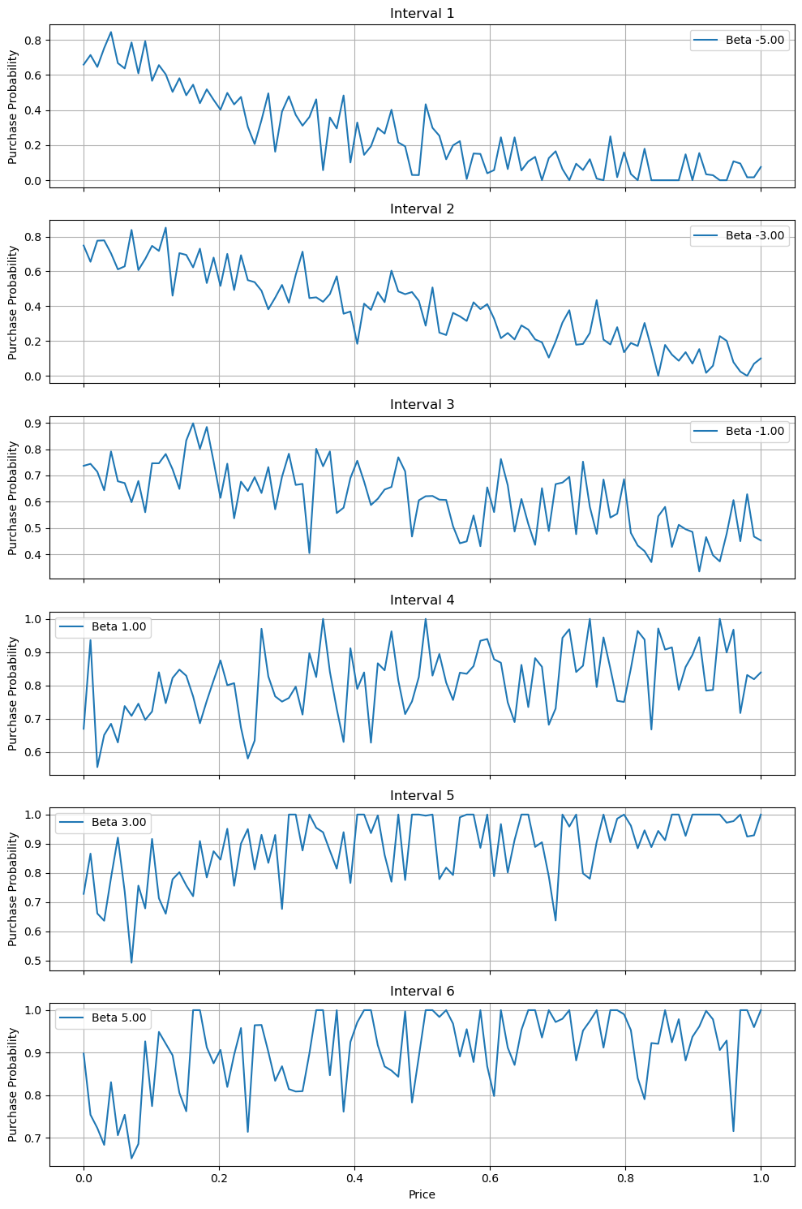

Environment
The focus is on developing a pricing strategy in a non-stationary environment where the demand curve is influenced by random noise and variance. The total duration is divided into distinct intervals and the demand curve changes to reflect market dynamics.
Uncertainty in customers’ behavior is modeled within each interval adding a Gaussian noise to the demand curve.
In each interval, the demand curve shifts based on a variance parameter. This variance controls how much the underlying parameter beta changes between intervals, thereby influencing the degree of change in the demand curve. Essentially, the variance determines both the rate and extent of beta's fluctuations, which in turn affects how significantly the demand curve evolves over time.
During each interval, the adjusted demand curve dictates the number of buyers at each price point. This approach aims to simulate a real-world scenarios where market conditions are unpredictable and continuously evolving.
Key parameters:
Number of Intervals: the total period is divided into 6 distinct intervals, each representing a phase where the demand curve can change.
Number of Days: the simulation runs over 10,000 days, in order to observe the performance of various pricing strategies over a long time.
Days per Interval: the total number of days is divided by the number of intervals. This parameter defines how many days an interval lasts.
Demand Curve Parameters β: A range of values, from -5 to +5, is used to control the behavior of the demand curve across different price intervals.
Prices: prices range from 0 to 1, with a detailed range of 100 points to evaluate how different price levels impact the likelihood of purchases.

Slide 29
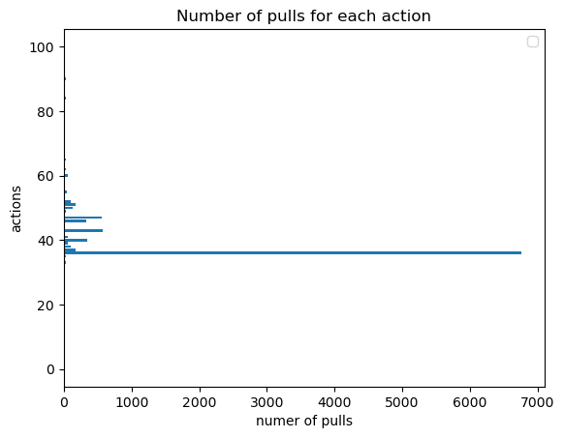
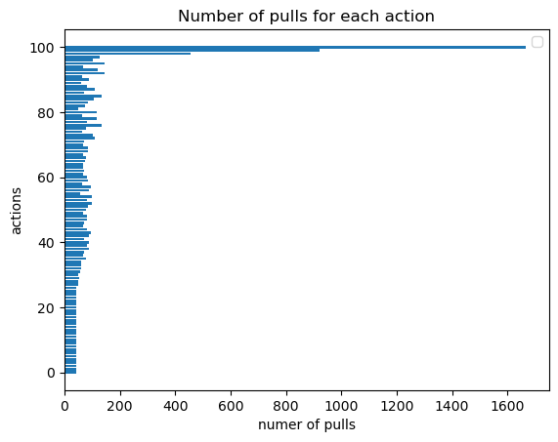
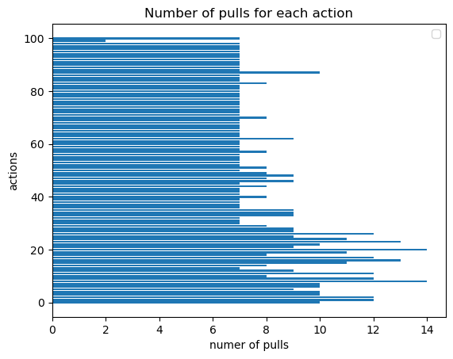
Agents
Three agents were implemented to address non-stationarity, enabling a comparative analysis of different strategies for handling the pricing problem.
UCB1
The UCB1 (Upper Confidence Bound 1) algorithm generally addresses the multi-armed bandit problem in stochastic settings.
It is included here for comparison, as it is expected to underperform in non-stationary environments.
Sliding Window UCB1
The Sliding Window UCB1 agent manages non-stationarity by focusing on a fixed-size window of W recent observations.
CUSUM UCB1
The CUSUM UCB1 agent builds on UCB1 by adding change detection to adapt to shifts in the environment. CUSUM operates in two phases:
Estimation
Detection

Slide 30
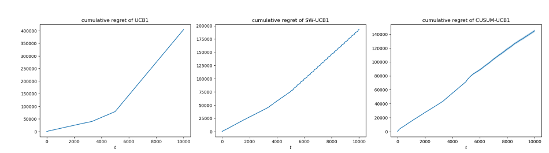
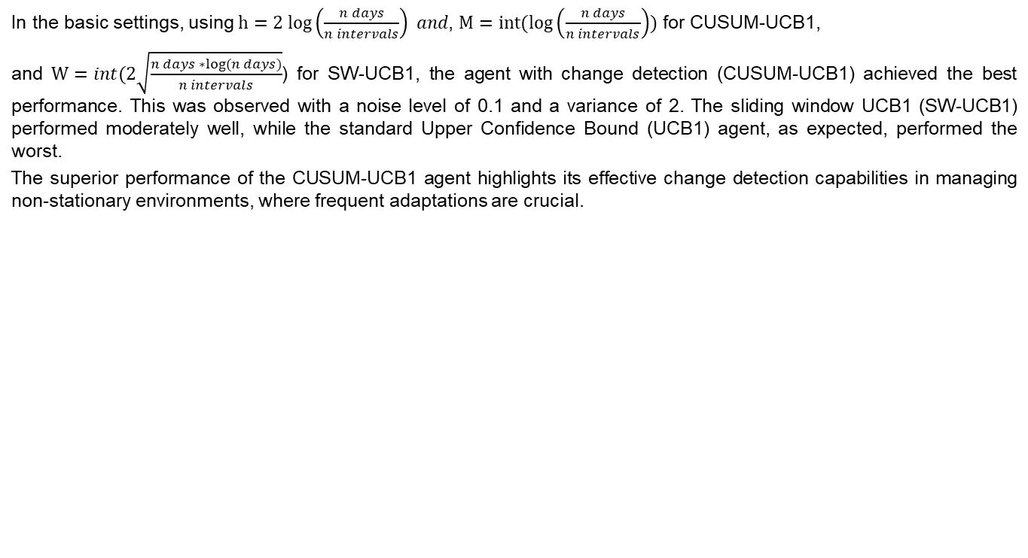
Results Basic Settings
In the basic settings, using $h=2 log\left(\frac{n days}{n intervals}\right) and\text{, }M=int(log\left(\frac{n days}{n intervals}\right))$ for CUSUM-UCB1,
and $W=int(2\sqrt{\frac{n days ∗log⁡(n days)}{n intervals}}$) for SW-UCB1, the agent with change detection (CUSUM-UCB1) achieved the best performance. This was observed with a noise level of 0.1 and a variance of 2. The sliding window UCB1 (SW-UCB1) performed moderately well, while the standard Upper Confidence Bound (UCB1) agent, as expected, performed the worst.
The superior performance of the CUSUM-UCB1 agent highlights its effective change detection capabilities in managing non-stationary environments, where frequent adaptations are crucial.

Slide 31
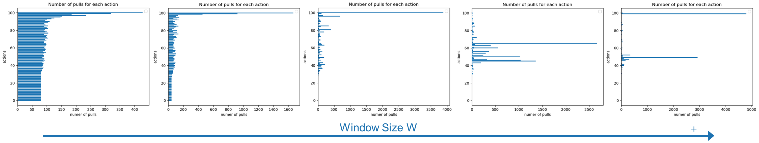
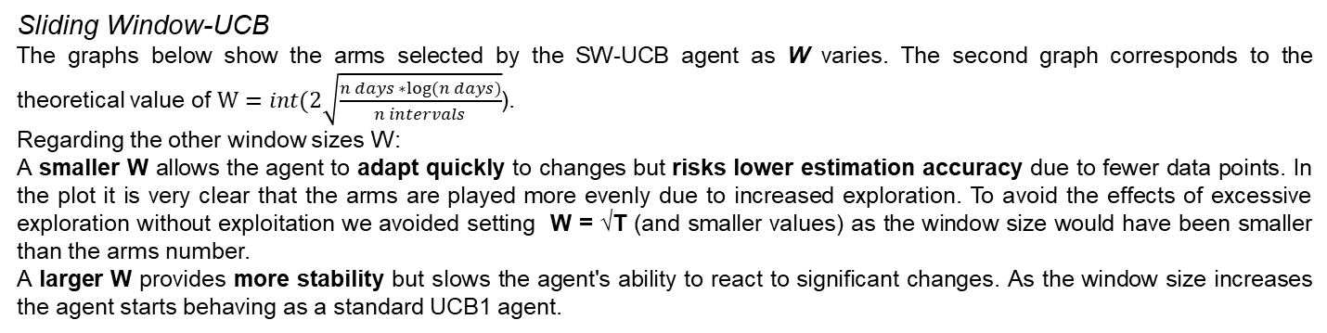
Results Changing W and h
An analysis was conducted on the agents' behavior within the environment by varying their parameters W and h. The aim was to understand how these parameters influence the agents' performance and behaviour in handling non-stationarity.
Specifically, W controls the agent's ability to adapt to recent changes, while h determines the agent's sensitivity to shifts in the environment.
Sliding Window-UCB
The graphs below show the arms selected by the SW-UCB agent as W varies. The second graph corresponds to the theoretical value of $W=int(2\sqrt{\frac{n days ∗log⁡(n days)}{n intervals}}$).
Regarding the other window sizes W:
A smaller W allows the agent to adapt quickly to changes but risks lower estimation accuracy due to fewer data points. In the plot it is very clear that the arms are played more evenly due to increased exploration. To avoid the effects of excessive exploration without exploitation we avoided setting W = √T (and smaller values) as the window size would have been smaller than the arms number.
A larger W provides more stability but slows the agent's ability to react to significant changes. As the window size increases the agent starts behaving as a standard UCB1 agent.

Slide 32
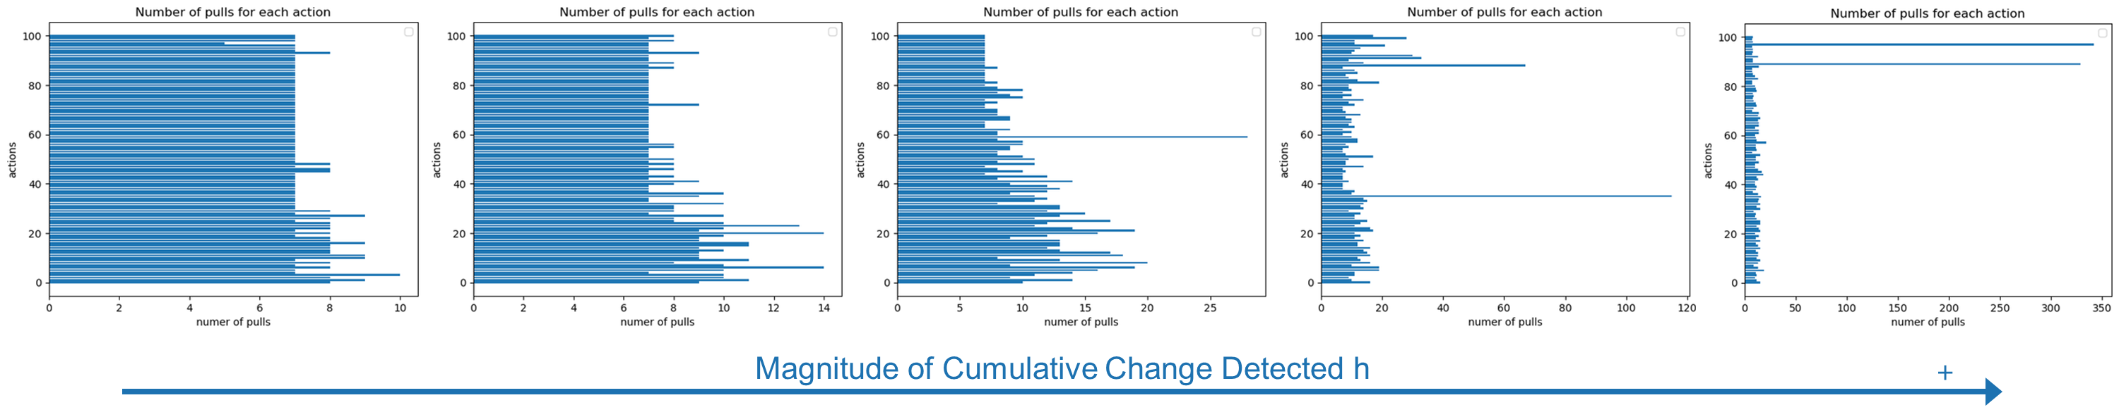
Results Changing W and h
CUSUM-UCB
The following graphs display the arms selected by the CUSUM-UCB agent as h varies. As with the previous example, the second plot uses the theoretical value for h, calculated as $h=2 log\left(\frac{n days}{n intervals}\right).$
With a lower h, the CUSUM-UCB agent is more sensitive to changes, which enhances exploration and results in a more even distribution of arm selections. This increased responsiveness can be beneficial in dynamic environments where frequent adjustments are necessary.
However, if h is set too low, the agent may reset excessively, leading to inefficient performance and frequent restarts in the learning process. In the graph this is visible because all the arms are almost equally selected, which means that the agent is stuck on the exploration phase.
On the other hand, a higher h reduces the frequency of change detection, resulting in more stable but less adaptive behavior. While this can prevent the agent from resetting too often, it risks missing important changes in the environment for prolonged periods. If the value of h is too high CUSUM-UCB and UCB1 behave in a very similar way.

Slide 33
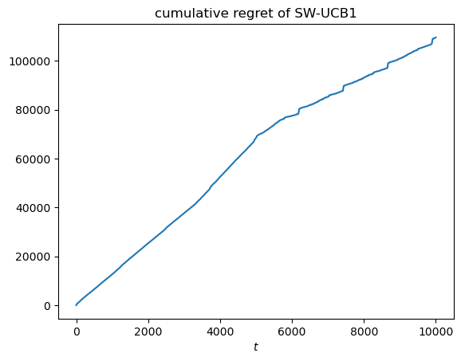



Results Changing W and h
In this context the best W size was the third one considered
$W=5∗int(2\sqrt{\frac{n days ∗log⁡(n days)}{n intervals}}$), which is larger than the theoretical value initially used.
In this highly noisy environment, a larger window size provides the necessary stability for the agents to perform effectively.
This increased stability helps the agents better manage the noise and adapt to the fluctuations in the demand curve, leading to improved performance.
The best performance for the CUSUM agent was achieved with the smallest h value $h=\frac{1}{2} log\left(\frac{n days}{n intervals}\right).$
This suggests that, despite the noisy environment requiring more stability in the window size, the CUSUM agent performed best with a more sensitive change detection threshold.
This smaller h value allowed the agent to detect changes more frequently, which was advantageous in adapting quickly to the fluctuating demand curve and achieving lower regret.

Slide 34



Results Number of Intervals
Similar considerations can be made regarding the number of intervals into which the days are divided, and consequently, the length of each interval.
When there are many short intervals, agents using change detection appear to have an advantage over the sliding window approach, likely due to its faster ability to adjust strategies.
For instance, in one scenario, the total number of days was set to 365*4, and the number of intervals to 16, representing a case where the demand curve for a product shifts each season of the year.
In this highly dynamic environment, where the demand curve changes frequently, the CUSUM agent achieved the lowest regret, while the sliding window approach proved largely ineffective, performing even worse than the standard UCB1 agent.

Slide 35
Conclusions Comments and Limitations
Instance-Dependent Agent Behavior
One significant limitation encountered in this assignment is the difficulty in making generalizable conclusions due to the highly instance-dependent behavior of the agents.
Each agent's performance is closely tied to the specific parameters of the environment, such as the noise level, the rate of change in the demand curve, and the length of the intervals.
This variability makes it challenging to get general insights on how these algorithms might behave in new environments with different characteristics.
Struggles in Simulating Real-World Seasonality
Simulating real-world demand seasonality posed significant challenges, particularly when using UCB1-like agents that require substantial exploration during the initial phases of learning.
In real-world situations, demand can shift rapidly due to seasonal effects, if the intervals are too short, the agents will spend most of the time exploring rather than adjusting to the true demand changes.
Furthermore, the patterns driven by seasonality tend to repeat consistently from one year to the next which, if considered, could allow for a more efficient learning process.
Abrupt vs. smooth changes
Although the environment in this study incorporates noise, it still features abrupt shifts at fixed intervals. This setup may not fully capture the gradual, continuous changes that may occur for certain goods’ demand. Moreover, what was said in this requirement may only apply to abrupt-changes environments.

Slide 36
Requirement 4

Slide 37



Environment and Agents
The agents take part in repeated Generalized First Price Auctions.
Multiplicative Pacing
FF Multiplicative Pacing
UCB with
Negative Feedback

Slide 38




Results Basic Settings
Simulation with one copy of each agent. FPA with 2 slots of equal value.
The simple MP agent outperforms the other agents.
The environment is equivalent to the non-stationary environment since the agents’ behaviour changes with their experience.

Slide 39


Results Extreme Settings
Using a 1000 of arms and 8000 users UCB struggles, as expected.
In a competitive setting with 25 agents per type, MP wins most of the auctions by outbidding all the other agents, but it leads to a poor gain in utility.

Slide 40




Results Different Valuations
Agent valuations:
$V_{MP}$= 0.4
$V_{FFMP}$ = 0.5
$V_{UCB}$= 0.5
In this setting FFMP and UCB learn to bid above the valuation of the MP agent.
FFMP beats the other agents and achieves sublinear regret.
MP still manages to win the lower slots while competing with the UCB agent.

